Slide 1



Summer Internship 2022
Department of Computer Engineering

Slide 2
Classification
The Classification algorithm is a Supervised Learning technique that is used to identify the category of new observations on the basis of training data.
In Classification, a program learns from the given dataset or observations and then classifies new observation into a number of classes or groups.
Such as, Yes or No, 0 or 1, Spam or Not Spam, cat or dog, etc. Classes can be called as targets/labels or categories.
In classification algorithm, a discrete output function(y) is mapped to input variable(x).
y=f(x), where y = categorical output

Slide 3
Classification is a two-step process, learning step and prediction step. In the learning step, the model is developed based on given training data. In the prediction step, the model is used to predict the response for given data.
The algorithm which implements the classification on a dataset is known as a classifier. There are two types of Classifications:
Binary Classifier: If the classification problem has only two possible outcomes, then it is called as Binary Classifier. Examples: YES or NO, MALE or FEMALE, SPAM or NOT SPAM, CAT or DOG, etc.
Multi-class Classifier: If a classification problem has more than two outcomes, then it is called as Multi-class Classifier. Example: Classifications of types of crops, Classification of types of music.

Slide 4
Use cases of Classification Algorithms
Classification algorithms can be used in different places.
Email Spam Detection
Speech Recognition
Identifications of Cancer tumor cells.
Drugs Classification
Biometric Identification, etc.
As a marketing manager, you want a set of customers who are most likely to purchase your product.
classifying customers into a group of potential and non- potential customers or safe or risky loan applications

Slide 5
Decision Tree Algorithm
A decision tree is a flowchart-like tree structure where an internal node represents feature(or attribute), the branch represents a decision rule, and each leaf node represents the outcome.
The topmost node in a decision tree is known as the root node. It learns to partition on the basis of the attribute value.
It partitions the tree in recursively manner call recursive partitioning. This flowchart-like structure helps you in decision making.
It's visualization like a flowchart diagram which easily mimics the human level thinking. That is why decision trees are easy to understand and interpret.

Slide 6
Decision Tree Induction: An Example
age | income | student | credit_rating | buys_computer
<=30 | high | no | fair | no
<=30 | high | no | excellent | no
31…40 | high | no | fair | yes
>40 | medium | no | fair | yes
>40 | low | yes | fair | yes
>40 | low | yes | excellent | no
31…40 | low | yes | excellent | yes
<=30 | medium | no | fair | no
<=30 | low | yes | fair | yes
>40 | medium | yes | fair | yes
<=30 | medium | yes | excellent | yes
31…40 | medium | no | excellent | yes
31…40 | high | yes | fair | yes
>40 | medium | no | excellent | no
Training data set: Buys_computer
Resulting tree:
age?
<=30
overcas
t
>40
31..40
student?
yes
credit rating?
yes
excellent
fair
no
no
yes
yes
6

Slide 7
Algorithm for Decision Tree Induction
Basic algorithm (a greedy algorithm)
Tree is constructed in a top-down recursive divide-and-conquer manner
At start, all the training examples are at the root
Attributes are categorical (if continuous-valued, they are discretized in advance)
Examples are partitioned recursively based on selected attributes
Test attributes are selected on the basis of a heuristic or statistical measure (e.g., information gain)
Conditions for stopping partitioning
All samples for a given node belong to the same class
There are no remaining attributes for further partitioning – majority
voting is employed for classifying the leaf
There are no samples left
7

Slide 8
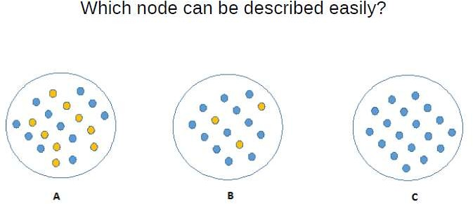

Slide 9
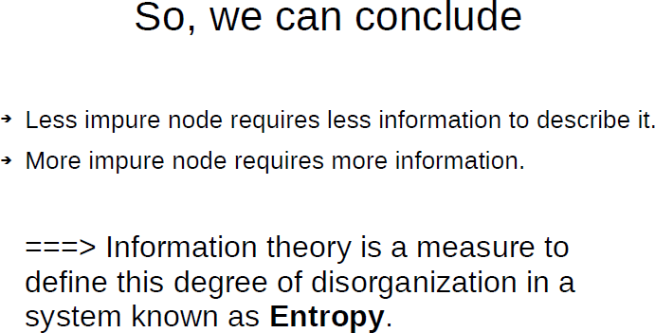

Slide 10
Attribute Selection Measure: Information Gain (ID3/C4.5)
Select the attribute with the highest information gain
Let p_{i} be the probability that an arbitrary tuple in D belongs to class C_{i}, estimated by |C_{i, D}|/|D|
Expected information (entropy) needed to classify a tuple
m
in D:
Info(D) = −∑ p_{i} log ₂ ( p_{i} )
i=1
v
| D |
Info (D) =
∑
j
Info(D )
A
| D |
j
j =1
Information needed (after using A to split D into v partitions) to classify D:
Gain(A) = Info(D) − Info_{A}(D)
Information gained by branching on attribute A
10

Slide 11
Attribute Selection: Information Gain
Class P: buys_computer = “yes”
Class N: buys_computer = “no”
Info (D) = ⁵ I (2,3) + ⁴ I (4,0)
age
14 14
Info(D) = I (9,5) = − ⁹ log ( ⁹ ) − ⁵ log ( ⁵ ) =0.940
+ ⁵ I (3,2) = 0.694
14 ² 14 14 ² 14
14
⁵ _{I (2,3)}means “age <=30” has 5 out of 14
age | p_{i} | n_{i} | I(p_{i}, n_{i})
<=30 | 2 | 3 | 0.971
31…40 | 4 | 0 | 0
>40 | 3 | 2 | 0.971
14
samples, with 2 yes’es and 3 no’s. Hence
Gain(age) = Info(D) − Info
age
(D) = 0.246
Similarly,
Gain(income) = 0.029 Gain(student) = 0.151 Gain(credit _ rating ) = 0.048
age | income | student | credit_rating | buys_computer
<=30 | high | no | fair | no
<=30 | high | no | excellent | no
31…40 | high | no | fair | yes
>40 | medium | no | fair | yes
>40 | low | yes | fair | yes
>40 | low | yes | excellent | no
31…40 | low | yes | excellent | yes
<=30 | medium | no | fair | no
<=30 | low | yes | fair | yes
>40 | medium | yes | fair | yes
<=30 | medium | yes | excellent | yes
31…40 | medium | no | excellent | yes
31…40 | high | yes | fair | yes
>40 | medium | no | excellent | no
11

Slide 12
age | income | student | credit_rating | buys_computer
<=30 | high | no | fair | no
<=30 | high | no | excellent | no
31…40 | high | no | fair | yes
>40 | medium | no | fair | yes
>40 | low | yes | fair | yes
>40 | low | yes | excellent | no
31…40 | low | yes | excellent | yes
<=30 | medium | no | fair | no
<=30 | low | yes | fair | yes
>40 | medium | yes | fair | yes
<=30 | medium | yes | excellent | yes
31…40 | medium | no | excellent | yes
31…40 | high | yes | fair | yes
>40 | medium | no | excellent | no

Slide 13
Gain Ratio for Attribute Selection (C4.5)
Information gain measure is biased towards attributes with a large number of
values
C4.5 (a successor of ID3) uses gain ratio to overcome the problem (normalization
to information gain)
v
| D | | D |
SplitInfo (D) = −
∑
j j
× log ( )
A
| D |
2
| D |
j =1
GainRatio(A) = Gain(A)/SplitInfo(A)
Ex.
gain_ratio(income) = 0.029/1.557 = 0.019
The attribute with the maximum gain ratio is selected as the splitting attribute
12

Slide 14
Gini Index (CART, IBM IntelligentMiner)
If a data set D contains examples from n classes, gini index,
gini(D) is defined as
n
∑
gini(D) =1−
_{p}2
j
j=1
where p_{j} is the relative frequency of class j in D
If a data set D is split on A into two subsets D₁ and D₂, the gini
index gini(D) is defined as
|D | |D |
(D) = gini( )+
gini( )
gini
1 2
D
1
D
2
Reduction in Impurity:
A
|D| |D|
Δgini(A) = gini(D)− gini_{A}(D)
The attribute provides the smallest gini_{split}(D) (or the largest reduction in impurity) is chosen to split the node (need to enumerate all the possible splitting points for each attribute)
13

Slide 15
Comparing Attribute Selection Measures
The three measures, in general, return good results but
Information gain:
biased towards multivalued attributes
Gain ratio:
tends to prefer unbalanced splits in which one partition is much smaller
than the others
Gini index:
biased to multivalued attributes
has difficulty when # of classes is large
tends to favor tests that result in equal-sized partitions and purity in both
partitions
14

Slide 16
Advantages of the Decision Tree
It is simple to understand as it follows the same process which a human follow while making any decision in real-life.
It can be very useful for solving decision-related problems.
It helps to think about all the possible outcomes for a problem.
There is less requirement of data cleaning compared to other algorithms.
Disadvantages of the Decision Tree
The decision tree contains lots of layers, which makes it complex.
It may have an overfitting issue, which can be resolved using the Random Forest algorithm.
For more class labels, the computational complexity of the decision tree may increase.

Slide 17
Example of Decision Tree
User ID | Gender | Age | EstimatedSalary | Purchased
15624510 | Male | 19 | 19000 | 0
15810944 | Male | 35 | 20000 | 0
15668575 | Female | 26 | 43000 | 0
15603246 | Female | 27 | 57000 | 0
15804002 | Male | 19 | 76000 | 0
15728773 | Male | 27 | 58000 | 0
15598044 | Female | 27 | 84000 | 0
15694829 | Female | 32 | 150000 | 1
15600575 | Male | 25 | 33000 | 0
15727311 | Female | 35 | 65000 | 0
15570769 | Female | 26 | 80000 | 0
15606274 | Female | 26 | 52000 | 0
15746139 | Male | 20 | 86000 | 0
15704987 | Male | 32 | 18000 | 0
15628972 | Male | 18 | 82000 | 0

